Slide 1
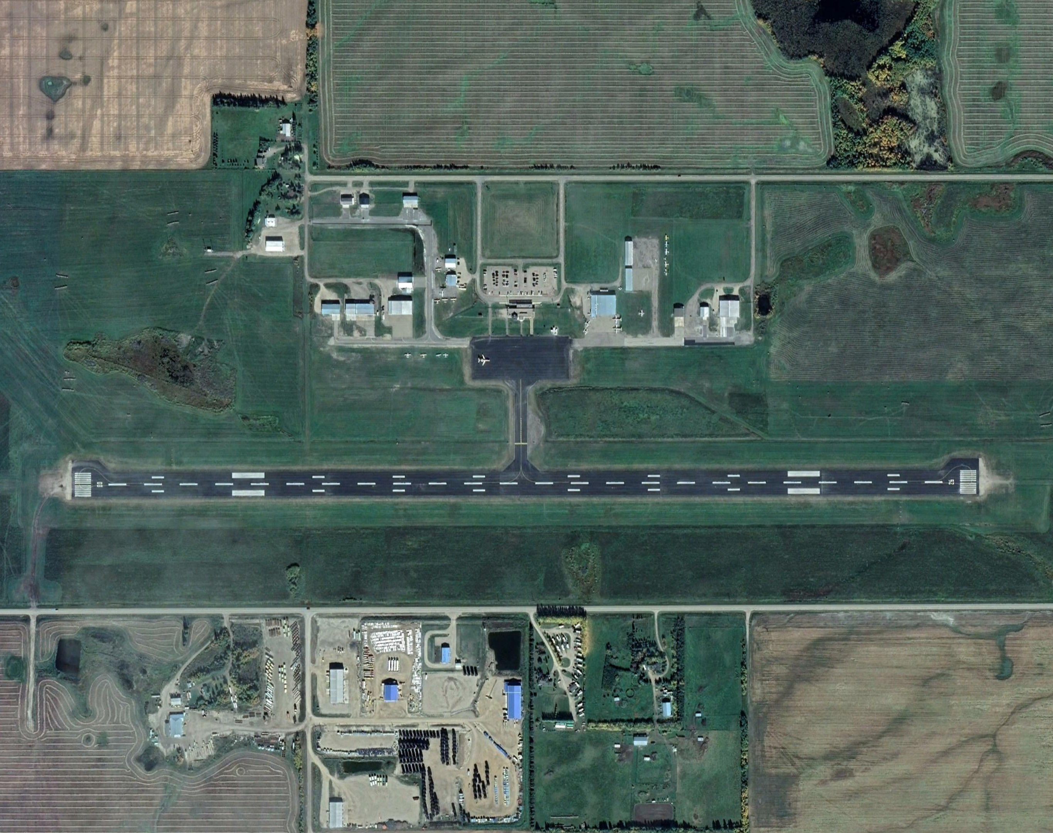
Lloydminster Airport
MASTER PLAN STAKEHOLDER WORKSHOP
Notes:
To change picture:
Delete picture
Add another picture by clicking the picture icon
Right click and send it to back
You are done

Slide 2

Agenda
Company Background
Project Leads
What is a Master Plan?
STAKEHOLDER WORKSHOP
Airport Profile
Demand Assessment
Deficiencies and Requirements
Business Development Plan

Slide 3

COMPANY BACKGROUND
HM Aero provides comprehensive aviation consulting services to the domestic and international aviation industry. HM Aero’s objective is to provide each client with the best aviation solution, tailored to their specific needs. HM Aero’s team of seasoned planners, engineers, project managers and other specialists are passionate about what we do, and we work exclusively on aviation-related assignments.
HM AERO
AVIATION CONSULTING
Notes:
To change picture:
Delete picture
Add another picture by clicking the picture icon
Right click and send it to back
You are done

Slide 4




OUR SERVICES
AIRPORT
PLANNING
MANAGEMENT ADVISORY
BUSINESS DEVELOPMENT
PROJECT
MANAGEMENT
Arctic and Remote Operations
Airport Master Planning
Climatology and Airport Availability Assessments
Commercial and Subdivision Planning
Demand Forecasting
Ground Support Facilities and Services
Land Use Planning
Obstruction Analysis and Zoning
Site Selection Studies
Development Planning and Analysis
Airline and Airport Evaluations
Governance and Privatization
Management Reviews and Audits
Management Training
Organizational Review and Development
Owner Advisory Services
Peer Reviews
Regulatory Reviews
Safety Management Systems
Safety Reviews
Air Service Development
Air Service Marketing
Airport Business Planning
Financial Planning
Marketing Plans
Bid Assistance
Owner’s Representation
Project Requirements Definition
Proposal Evaluation and Assessment
RFP, Tender and Specification Preparation

Slide 5



PROJECT LEADS
R. Adam Martin, M.Sc., PMP
Andrew Macdonald, B. Comm.
President, Senior Project Director
Manager, Aviation Planning
As President of HM Aero, Adam Martin has more than 18 years’ experience in the aviation industry and is a highly-skilled airport planner, commercial pilot and Project Management Professional. He led a team of more than 20 aviation planning staff in his role of Manager, Aviation Planning at WSP Canada, where he was employed for more than 13 years and was involved in more than 100 projects.
Andrew has participated in planning, design, and forecasting activities; Instrument Flight Procedure design; topographic survey coordination; airport business plans and business case studies; airport master plans and commercial plans; apron and gate designs, obstacles assessments, and specialized studies at numerous airports throughout Canada.

Slide 6
WHAT IS A MASTER PLAN?
STAKEHOLDER ENGAGEMENT
DEFICIENCIES AND REQUIREMENTS
AIRPORT PROFILE
AIRPORT DEVELOPMENT PLAN
DEMAND ASSESSMENT
BUSINESS DEVELOPMENT PLAN

Slide 7
AIRPORT PROFILE
BACKGROUND DATA REVIEW
STAKEHOLDER CONSULTATIONS
SOCIO-ECONOMIC PROFILE
SWOT ANALYSIS
AIRPORT ROLE & VISION
AIRPORT GROWTH OBJECTIVES

Slide 8




DEMAND ASSESSMENT
YLL
ACTIVITY FORECAST
ECONOMIC IMPACT
AIRLINE OPERATIONS
DESIGN AIRCRAFT

Slide 9
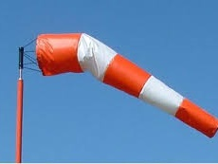

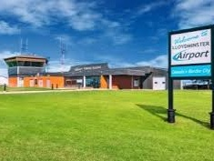
DEFICIENCIES AND REQUIREMENTS
AIRSIDE
GROUNDSIDE
ATB & OTHER
RUNWAYS
TAXIWAYS
APRONS
LIGHTING
NAV AIDS
ACCESS ROADS
PARKING
TERMINAL BUILDING
COMMERCIAL DEVELOPMENT

Slide 10




DEVELOPMENT PLAN
DEVELOPMENT PLAN
CAPITAL PLAN
Based on the inputs from the previous phases and considering the airport activity forecasts, HM Aero will prepare a 25-year Airport Development Plan for Lloydminster Airport
Will consider asset replacement and new development initiatives; employ industry best practices and aviation activity forecasts to determine timing for capital investment
ENVIRONMENTAL ASSESSMENT
LAND USE PLAN
A natural environment desktop review will be undertaken in areas with the potential to be impacted by proposed developments
The Land Use Plan will ensure recommended land uses are in alignment with the airport’s strategic and development objectives and will support progressive development of airport lands to minimize conflicts

Slide 11
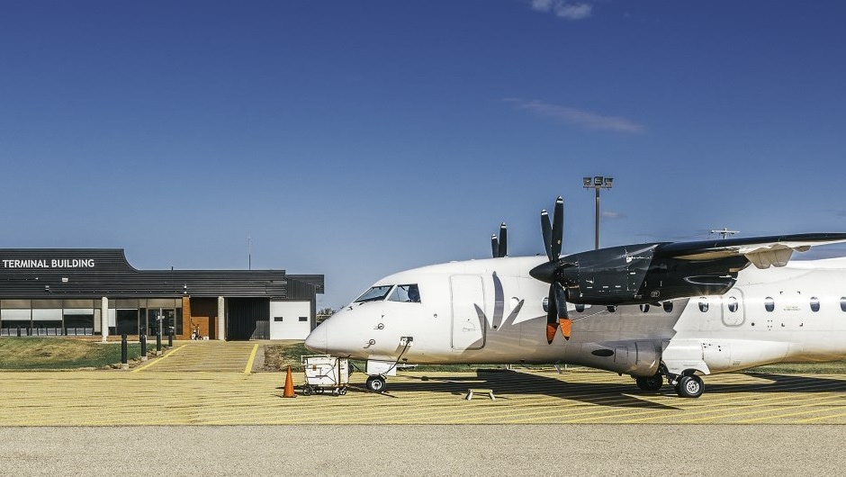
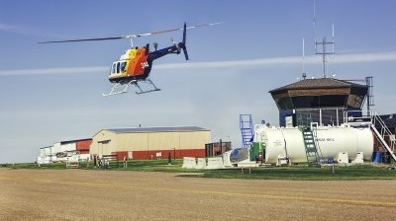
CURRENT & NEW BUSINESS PARTNERS
REVENUE OPPORTUNITIES
BUSINESS DEVELOPMENT PLAN
3
MARKETING PLAN AND KPI
4
PRO FORMA FINANCIAL STATEMENTS
Notes:
To change picture:
Delete picture
Add another picture by clicking the picture icon
Right click and send it to back
You are done

Slide 12
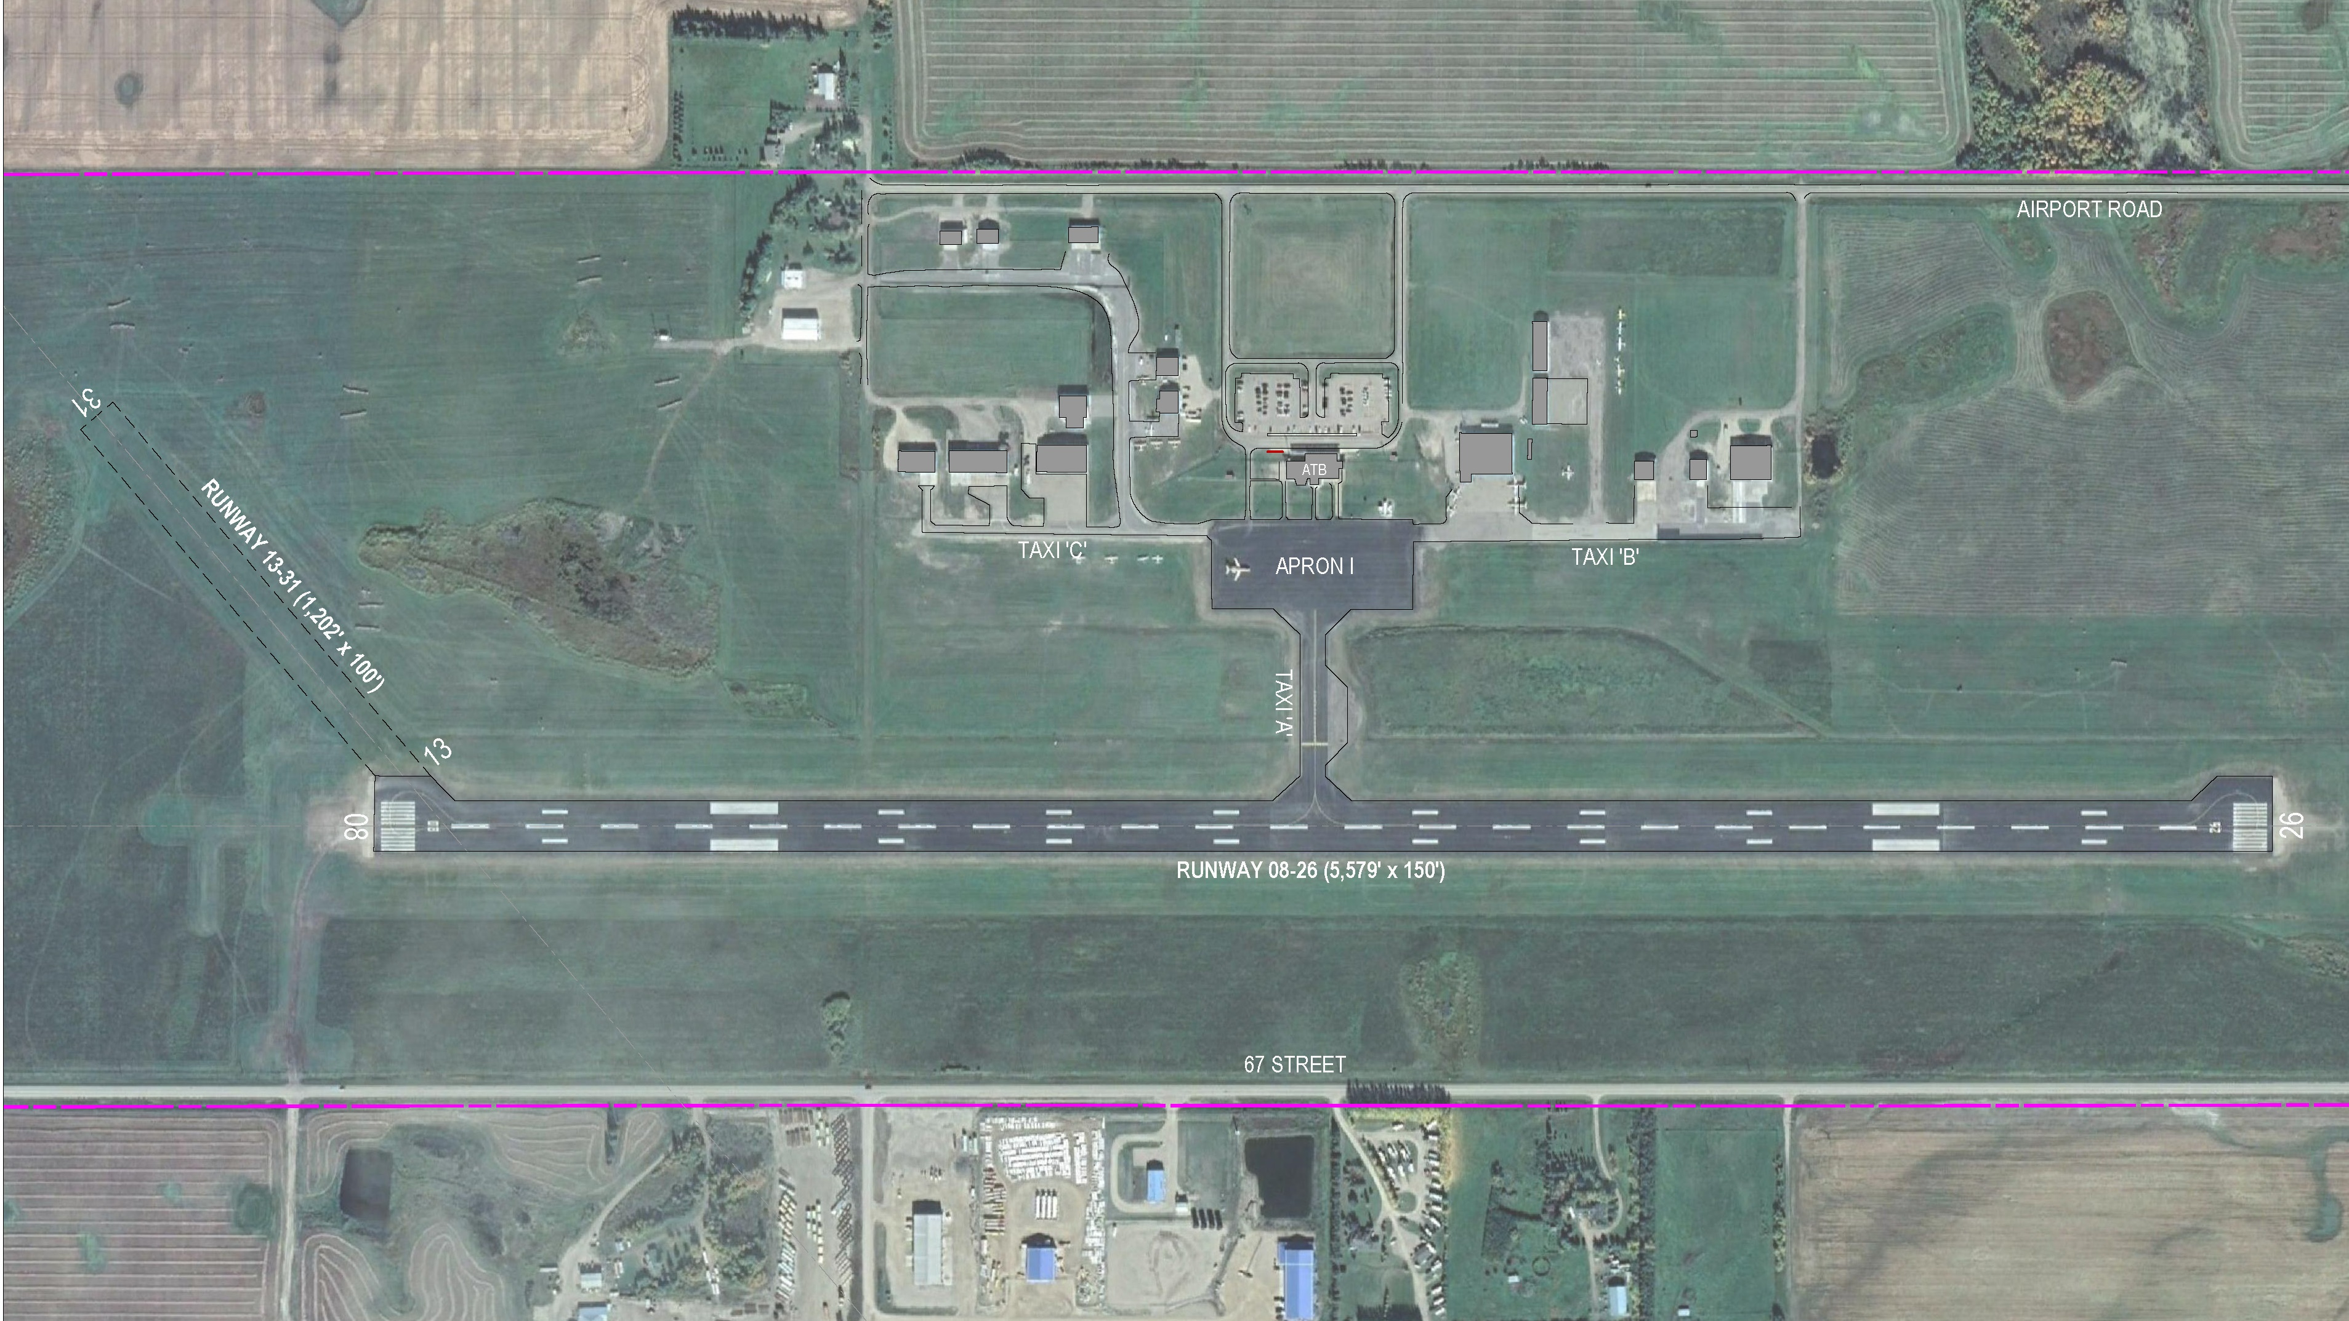

Notes:
To change picture:
Delete picture
Add another picture by clicking the picture icon
Right click and send it to back
You are done

Slide 13

Notes:
To change picture:
Delete picture
Add another picture by clicking the picture icon
Right click and send it to back
You are done

